Slide 1
Visual tools for process analysis and improvement Pareto charts, histograms, run charts, scatter diagrams, etc.
BUSI 104 – Operations Management
Professor Ed Arnheiter

Slide 2
Common Tools of Process Analysis and Improvement
Process Flow Diagrams (broadly defined, this can be tabular as well)
Cause & Effect diagrams (fishbone diagrams)
Run Charts
Histograms
Checklists (a data collection technique)
Pareto Charts
Scatter Diagrams

Slide 3
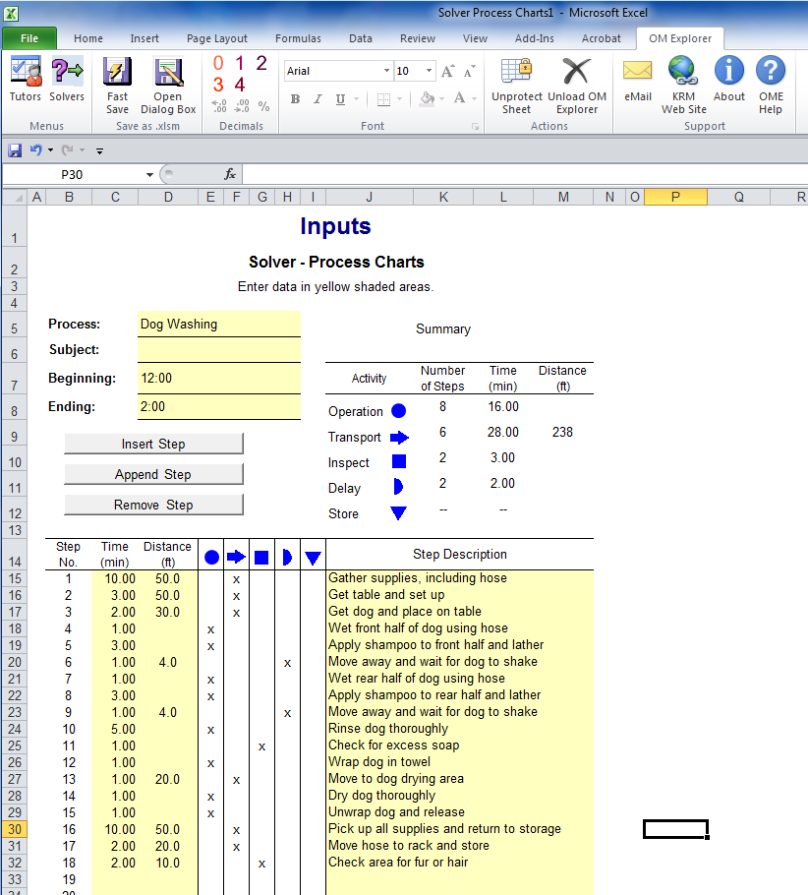
Using OM Explorer to Create Process Charts
OM Explorer>Solvers>Process Analysis>Process Charts

Slide 4
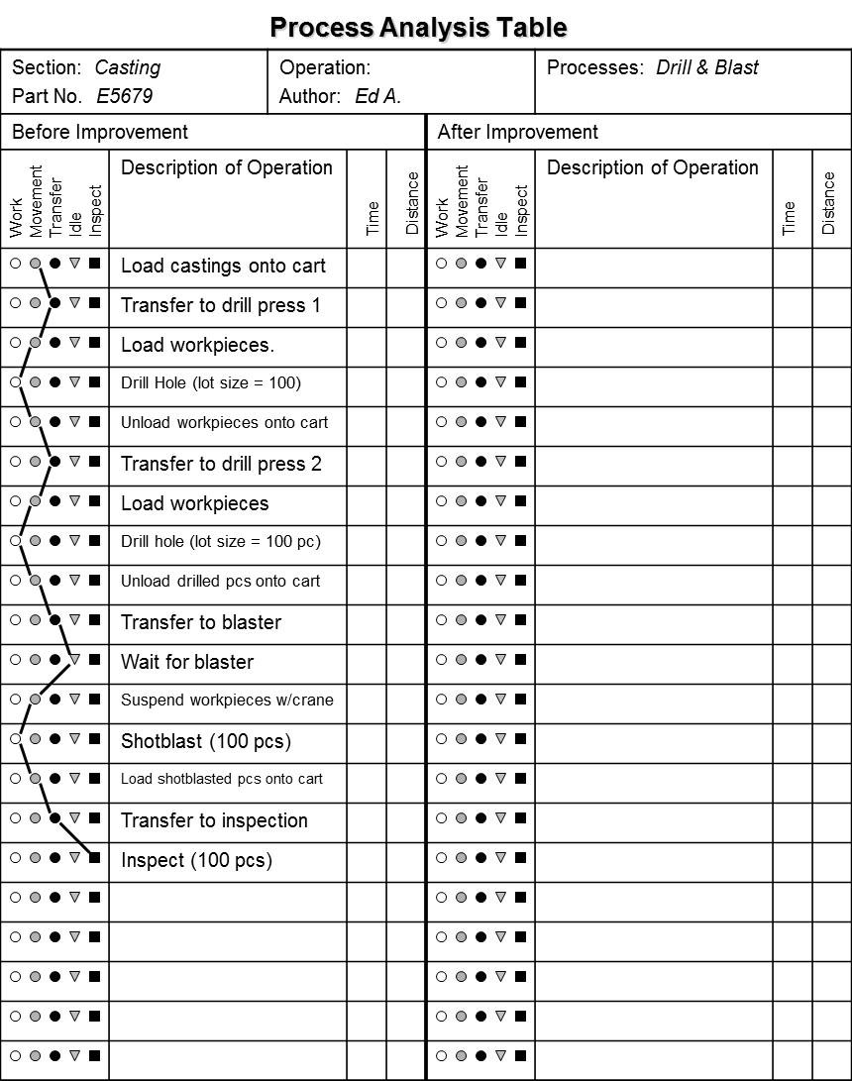
Process Chart in Tabular Form

Slide 5
Cause-and-effect Diagrams
Visual brainstorming tool used to isolate ONE specific defect, problem, or undesirable condition and determine potential causes.
Categorization helps identify causes and link common causes that can be addressed by similar solutions.
After developing diagram, classify variables as Constant, Noise, or Experimental.
C = Constant: This task is currently controlled with an SOP
N = Noise: This task currently is not controlled. Control it with an SOP if possible. Leave it as an N if necessary.
X = Experimental: I am experimenting with this task
Materials
Measurement
Manpower
________
________
________
________
________
________
________
________
________
________
________
________
Problem or
Defect
________
________
________
________
________
________
Machinery
Methodology
Mother Nature

Slide 6
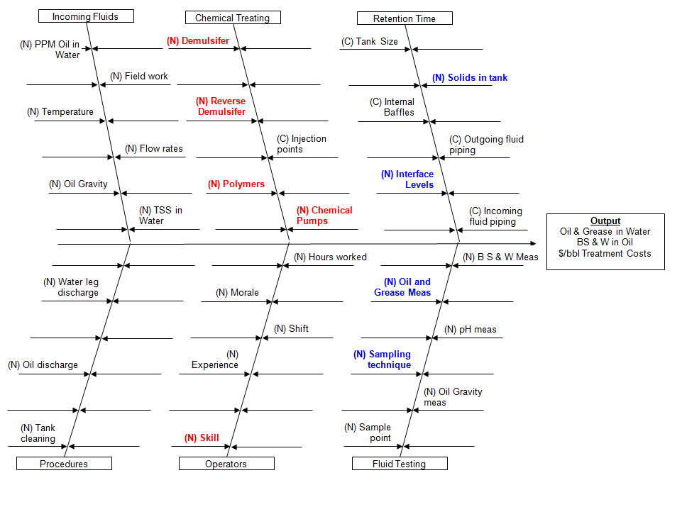
Cause-and-effect Diagram Example

Slide 7
Run Chart Features
Vertical axis shows numerical value of output
Data points plotted in sequential order
Points are connected by a line to aid in visual interpretation

Slide 8
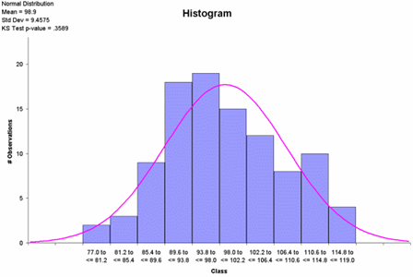
Histograms

Slide 9
Pareto Principle
80% of the effects can be traced to 20% of the causes (the “vital few”)
Named after Vilfredo Pareto, an Italian economist, who observed that vast majority of wealth was in the possession of only a few people

Slide 10
Pareto Charts
Visual depiction of Pareto principle
Useful for drilling down into root causes.
Vertical axis shows count of data points
Bar height shows relative importance, in
descending order
Vertical axis shows percentages
Red line shows cumulative percentages
Bars represent each stratified category
“Other” category combines stragglers

Slide 11
Scatter Diagrams
.
.
.
.
.
.
.
.
.
.
.
.
Positive correlation
An increase in X is likely to be associated with an increase in Y
No correlation
The Y response is likely to be dependent on some other variable
Negative correlation
An increase in X is likely to be associated with a decrease in Y
.
Y
X
.
.
.
.
.
.
.
.
.
.
Y
.
.
.
.
X
.
.
.
.
.
.
.
.
.
.
.
Y
.
.
X

Slide 12
Scatter Diagram for Customer Satisfaction
x
x
x
x
x
x
x
x
x
x
x
x
x
x
x
x
x
x
x
x
x
x
x
x
x
x
x
x
Customer Satisfaction
x
x
x
x
x
x
x
x
x
x
x
x
x
0
5.0
10.0
Time Spent in Queue (minutes)

Slide 13
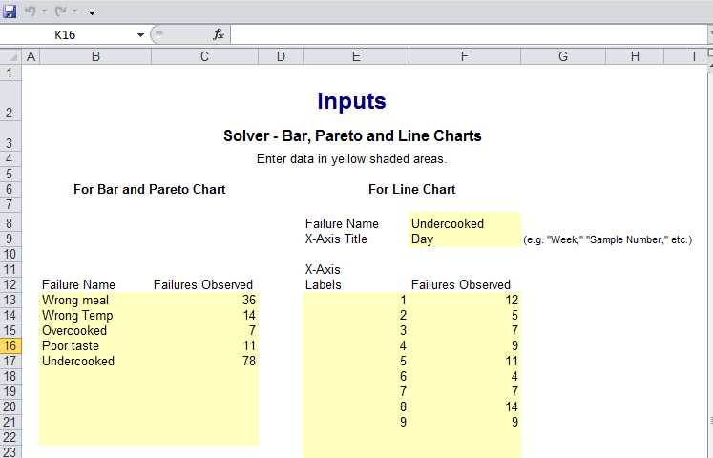
Using OM Explorer to Create Bar, Pareto and Run Charts
OM Explorer>Solvers>Process Analysis>Bar. Pareto and Line Charts

Slide 14
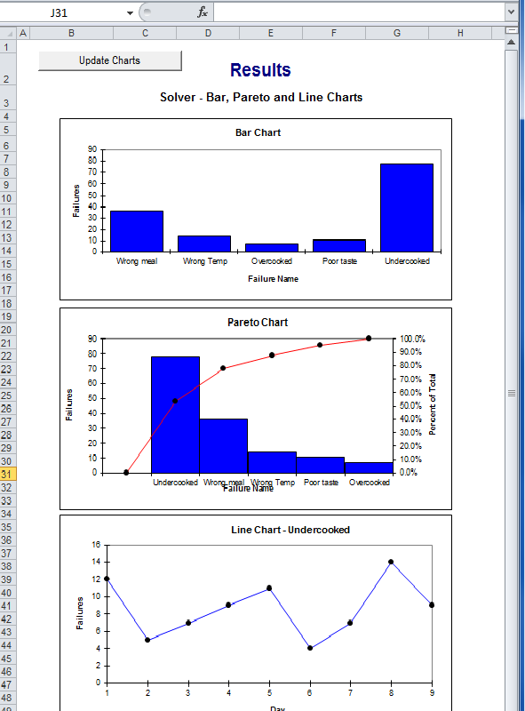
OM Explorer Results

